Slide 1

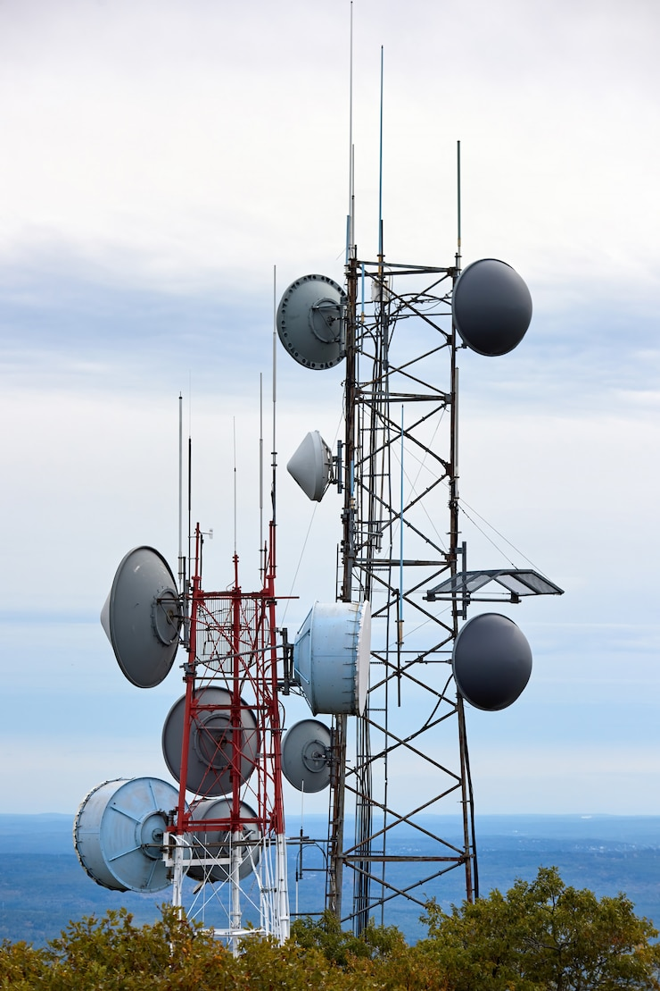

User Analytics in the Telecommunication
Industry -Overview
Chethana S S
Nexthikes IT Solutions

Slide 2

Objective:
Use user analytics to better understand customer behaviors, preferences, and service experience, leading to improved business decisions and customer satisfaction.
Sub-Objectives:
User Overview Analysis
User Engagement Analysis
User Experience Analysis
User Satisfaction Analysis
Global Objective

Slide 3
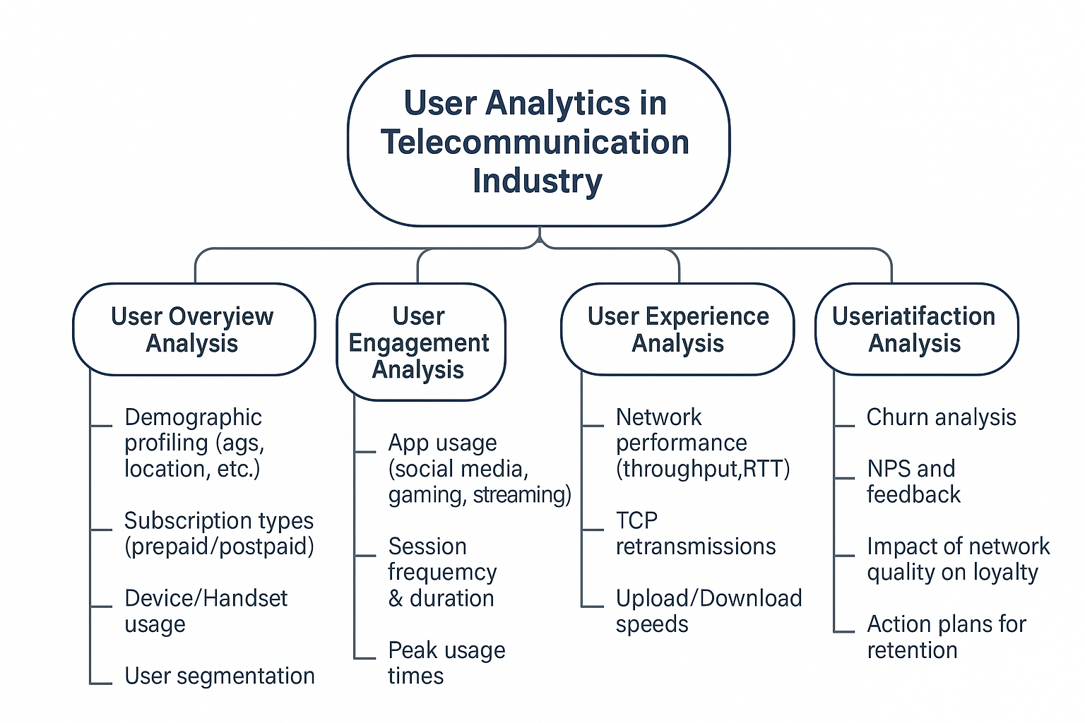

Slide 4

Purpose:
Gain a basic understanding of the telecom user base.
Key Points to Cover:
Profile the users by demographics (e.g., age, location, device brand).
Identify user segments based on usage behavior.
Analyze subscription types (prepaid vs. postpaid) and service plans.
Understand handset preferences and network access patterns.
Goal:
Build customer personas and find target groups for focused marketing.
User Overview Analysis

Slide 5
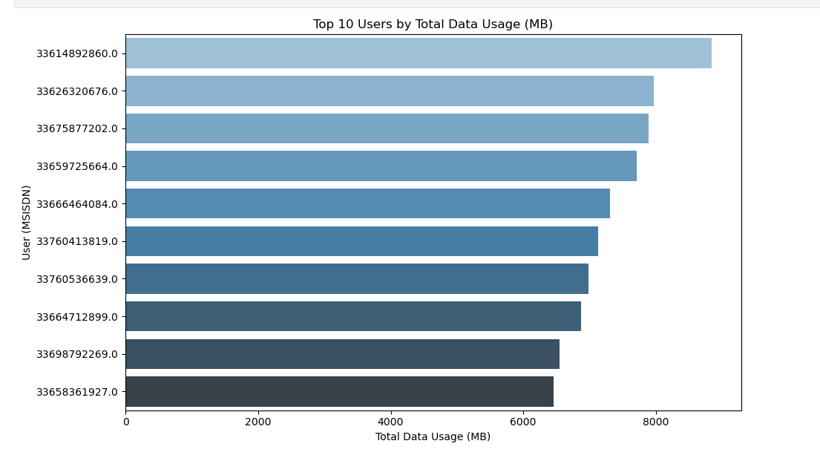
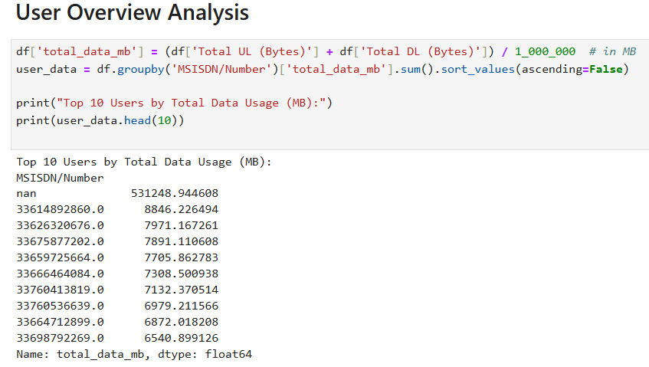
User Overview Analysis
Insight:
The top 10 users contribute significantly to the overall network data usage.
There is a steep drop in total data usage after the top few users, indicating that a small group of users are heavy consumers of mobile data services.
These top users might be priority customers for premium plans or could be targeted for personalized offers to improve retention and satisfaction.

Slide 6
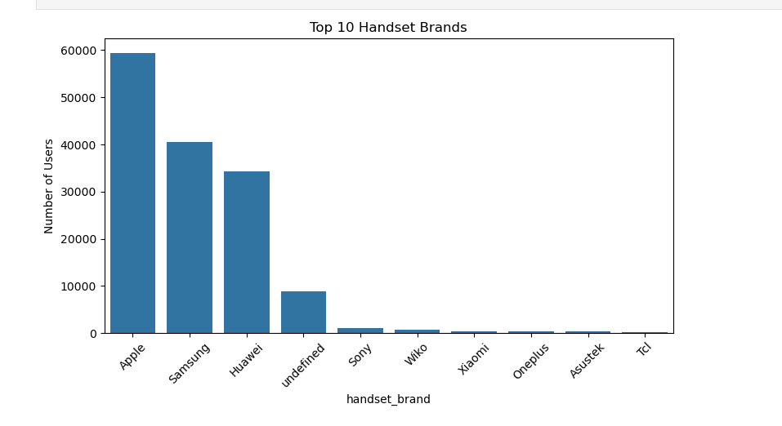
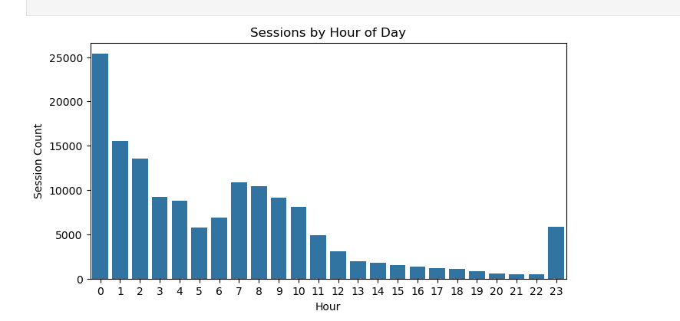
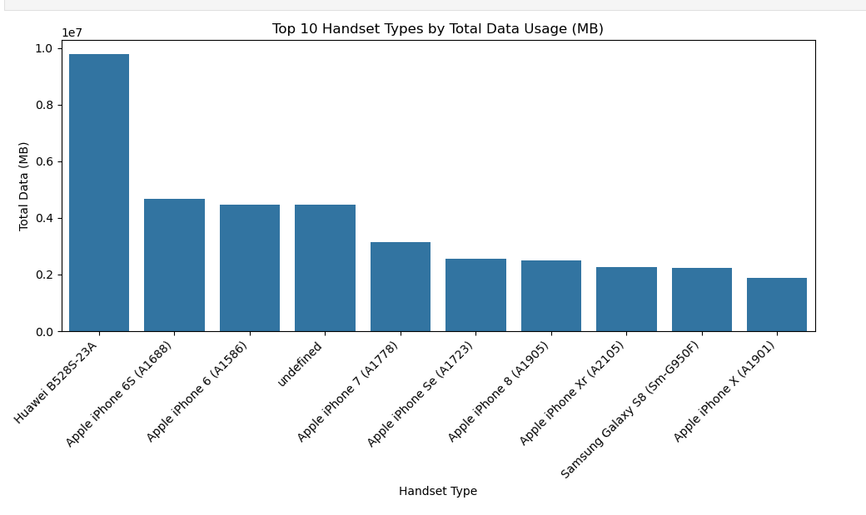
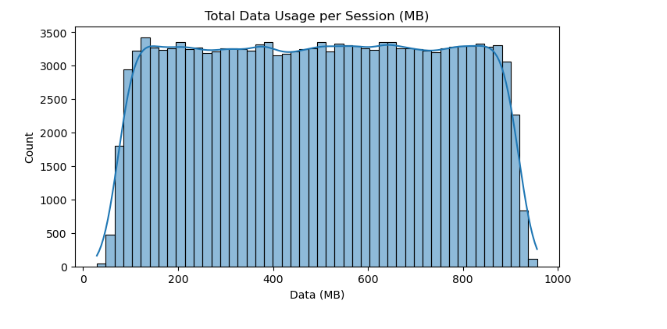
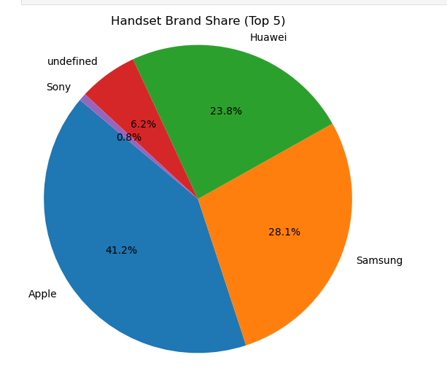
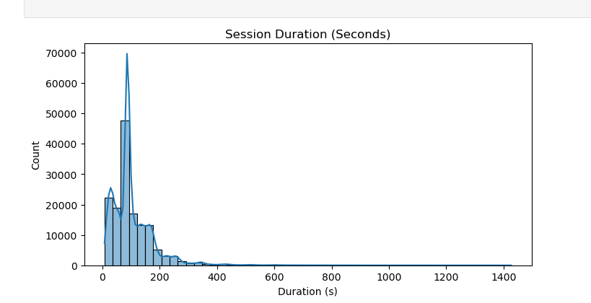
Continued.......
Sessions by Hour of Day
Top 10 Handset Brands
From the graph we can analyse Apple is the top most Brand that using by users in most
Top 10 Users by Data Consumption
According to data usage the top most users are Huawei mobiles using users
Handset Brand Share according to the market,Top most is Apple
Total Data Usage Distribution
Distribution of Session Duration

Slide 7
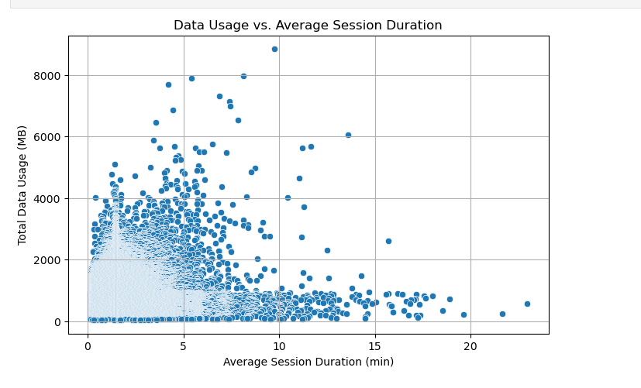
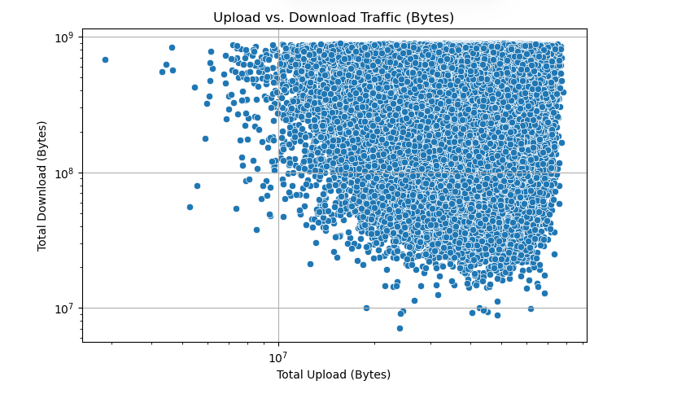
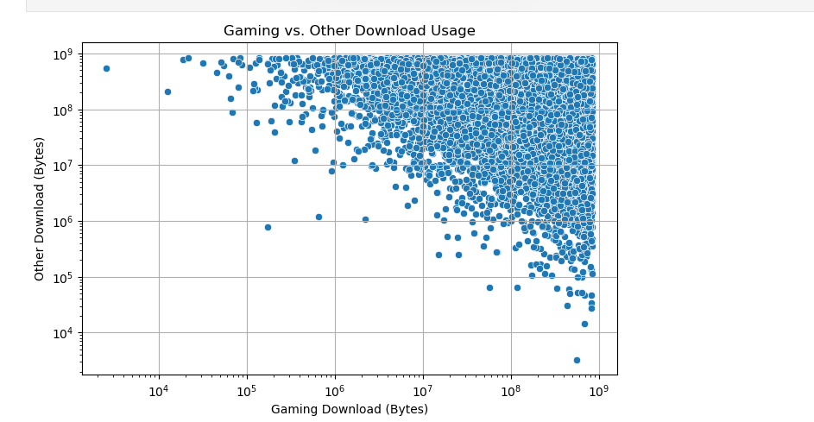
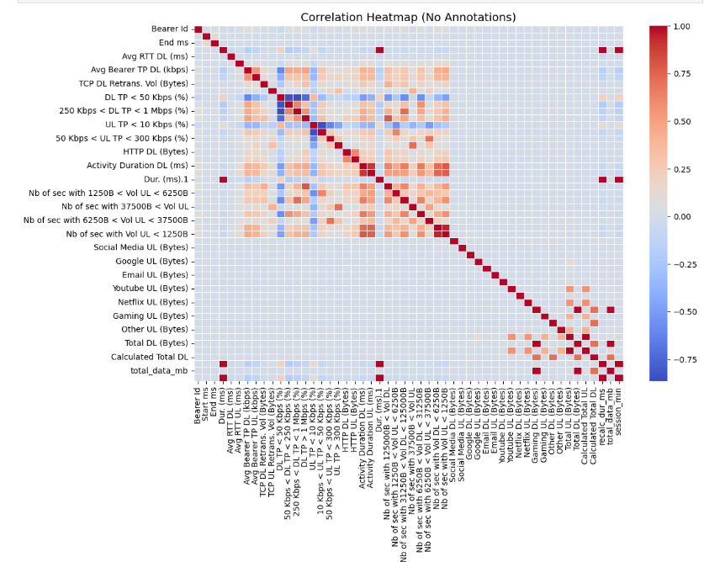
Continued.......
There is a positive relationship between session duration and total data usage — users who spend more time per session generally consume more data.
Users show higher download traffic compared to upload, with a few heavy uploaders indicating specialized usage behaviors such as cloud backups or large file transfers
Gaming downloads are niche and less correlated with general data consumption, revealing a distinct heavy-user segment
Strong correlations between upload and download volumes; moderate app-specific influences on total data usage detected.

Slide 8
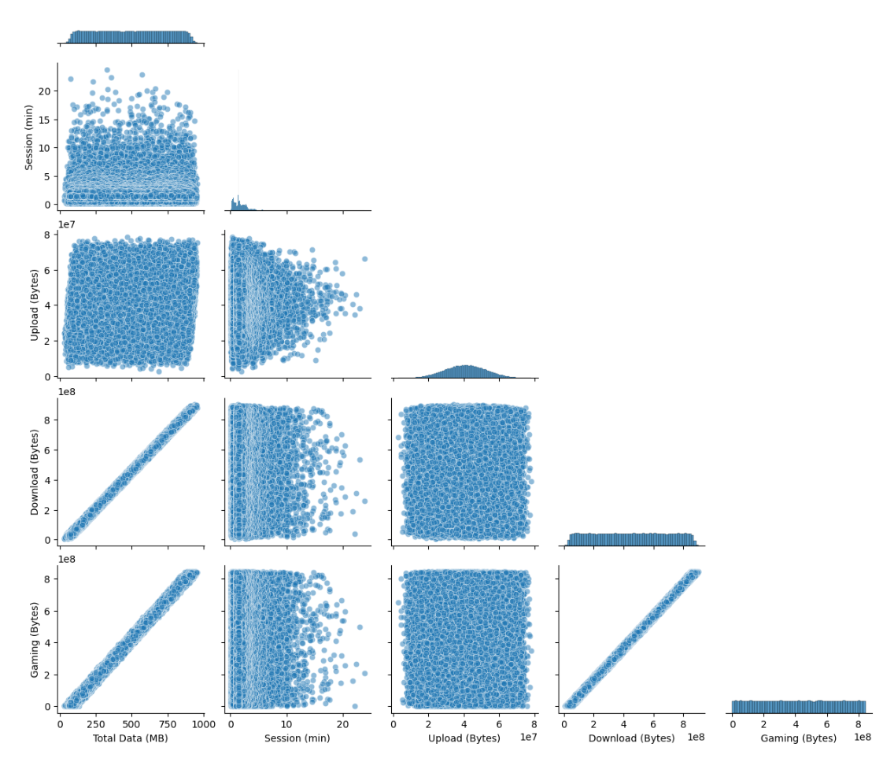
Plot the pairplot
The pairwise plot provides a visual understanding of the relationships between key telecom usage metrics.
Some variables display clear positive linear relationships (e.g., Total Upload vs Total Download), confirming patterns seen in the correlation analysis.
Certain distributions (diagonal plots) show skewness, especially in metrics like Download Volumes and Session Duration, suggesting the presence of heavy users or outliers.
Scatterplots reveal clusters and density trends, hinting at the existence of distinct user groups based on their usage behavior.
These observations can guide feature selection, segmentation strategies, and data transformation (e.g., normalization or log-scaling) for further modeling.

Slide 9

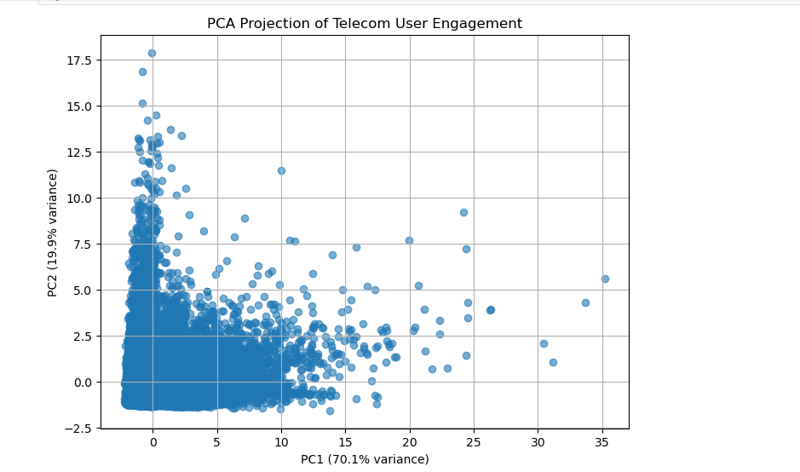
PCA on Telecom User Features
1.Principal Component 1 (PC1) explains the majority of variance, driven mainly by total data usage and upload or download activity.
2.Principal Component 2 (PC2) captures variation in session behavior, especially average session duration and count.
3.The PCA reveals clear spread patterns, suggesting users differ significantly in how they consume data versus how long or often they stay active.
4.PCA simplifies complex behavior into 2 dimensions, enabling clustering or segmentation without losing key user insights.
Performing Principal Component Analysis (PCA) on the telecom user features involves several steps. PCA is a dimensionality reduction technique used to identify patterns in data by transforming features into a smaller number of uncorrelated components, while retaining as much variance as possible.

Slide 10
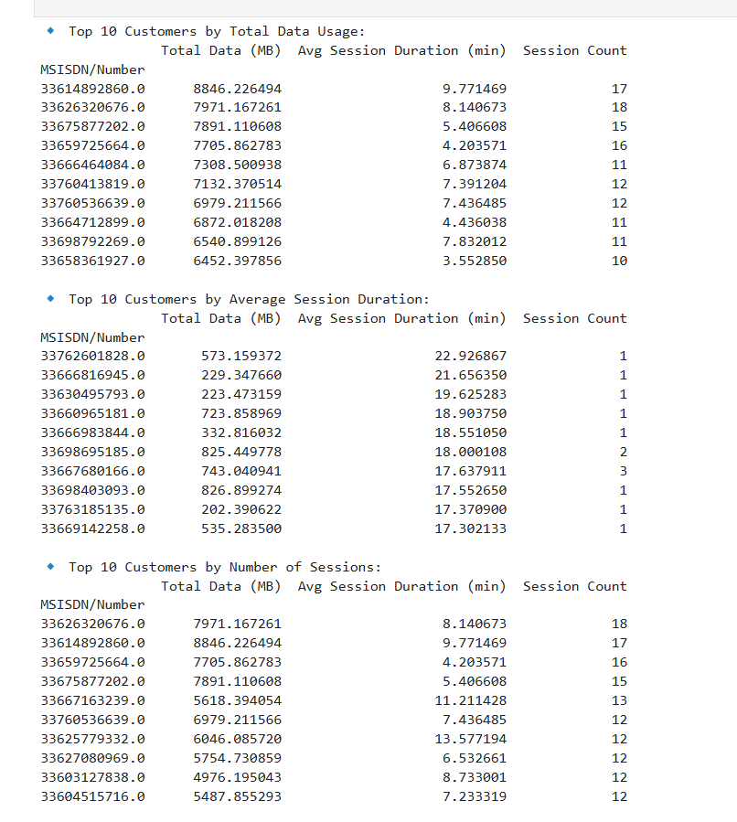
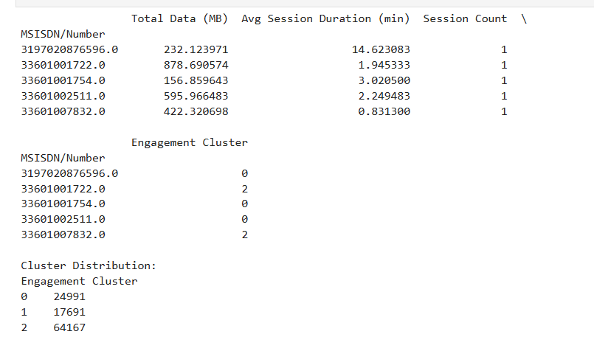
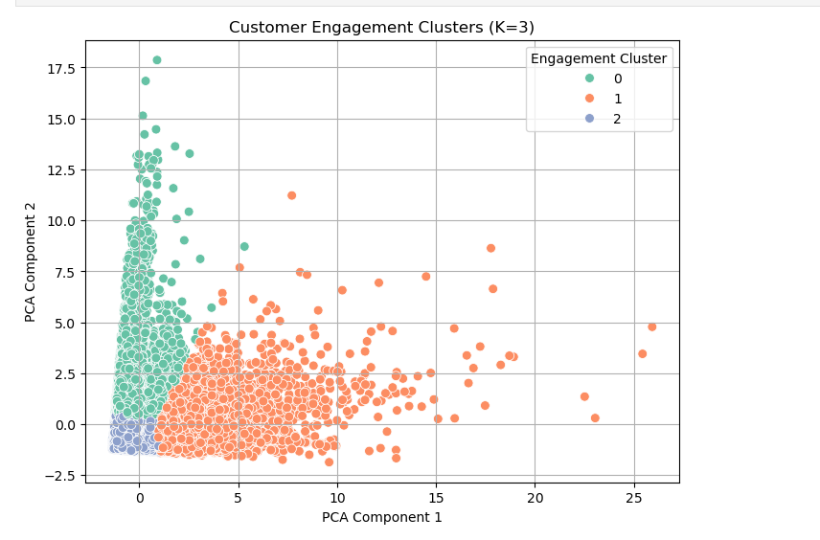
Top 10 Customers per Metric
Customer Engagement Clustering (K=3)
Visualize the Clusters (Optional, using PCA)
Users in the high-engagement cluster could receive special offers or more frequent updates.
Users in low-engagement clusters might need targeted campaigns to increase activity.

Slide 11
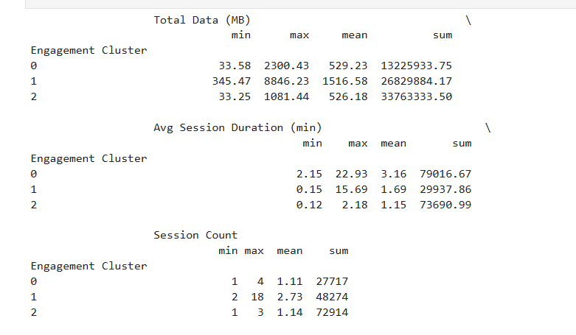
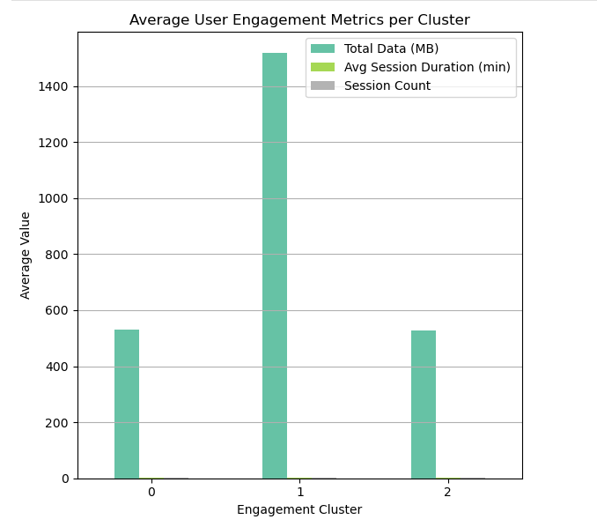
Compute Min, Max, Avg, Total Per Cluster
Visualize Cluster Metrics
1.Cluster 0 shows low data usage
2.Cluster 1 shows moderate usage across all metrics
3.Cluster 2 has very high data, long sessions, and many sessions, indicating heavy/power users highly engaged with the network.

Slide 12
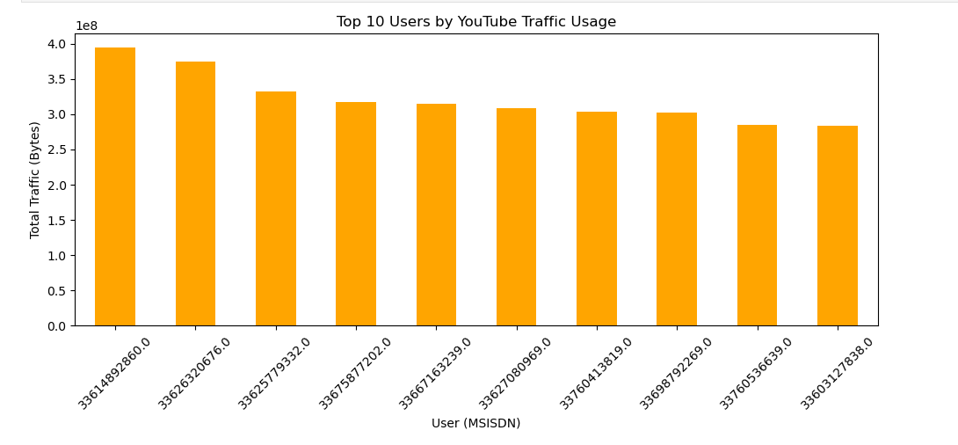
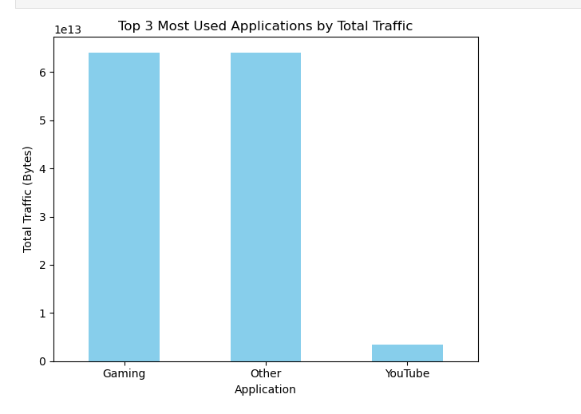
Bar plot for Top 10 users by Traffic
Top 3 Most Used Applications
The bar chart of the Top 10 YouTube Users by Traffic Usage provides a clear view of user engagement on YouTube. Key insights include:
High Traffic Users: Identify users with the highest data usage, which may highlight heavy YouTube consumers.
Traffic Distribution: The chart highlights the applications with the highest traffic usage, showing which apps are most dominant in terms of user data consumption.

Slide 13
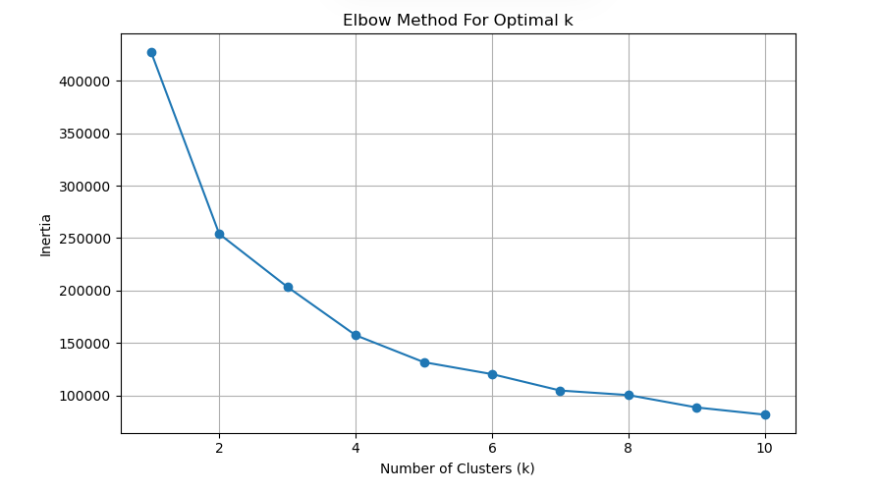
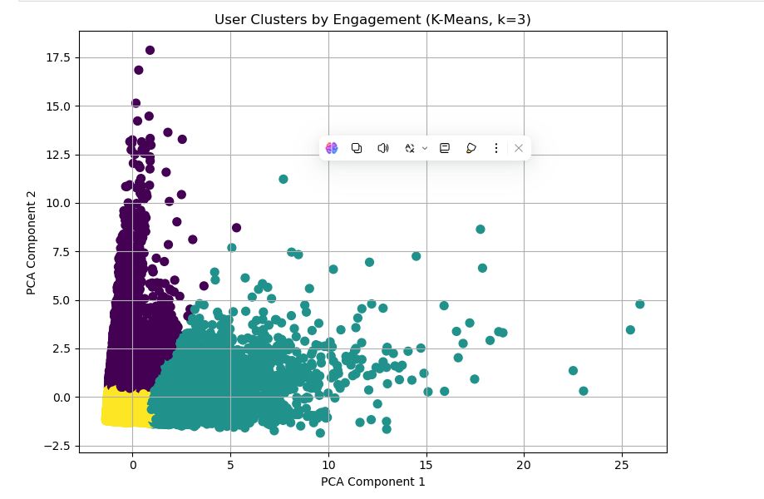
Elbow Method to Find Optimal k
Visualize Clusters (PCA 2D Plot)
Cluster Separation: The plot shows how users are grouped based on their engagement metrics, with color indicating different clusters (e.g., k=3 clusters).
Dimensionality Reduction: By reducing the data to two principal components, the plot offers a clearer view of user segmentation, making it easier to interpret complex patterns.
Engagement Patterns: Users are color-coded according to their assigned cluster, helping identify behavior patterns within the groups.
The Elbow Method plot helps determine the optimal number of clusters (k) for K-Means clustering by examining the inertia (sum of squared distances from each point to its assigned cluster center) for different values of k

Slide 14
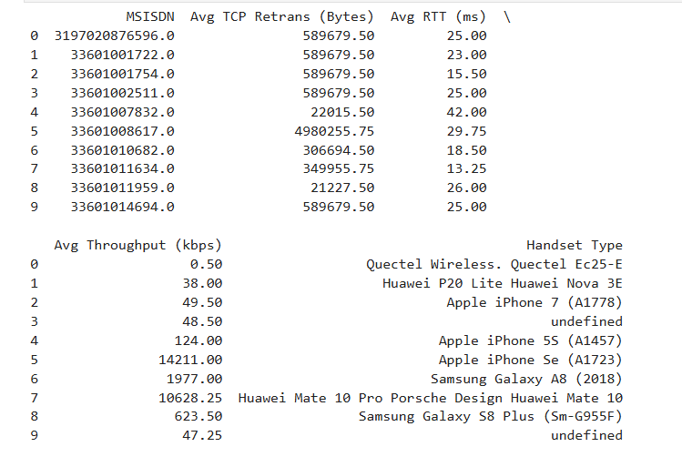
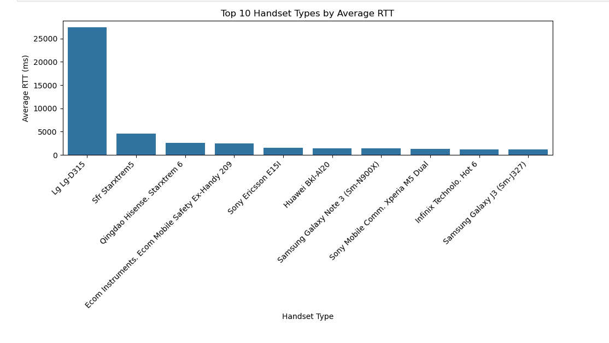
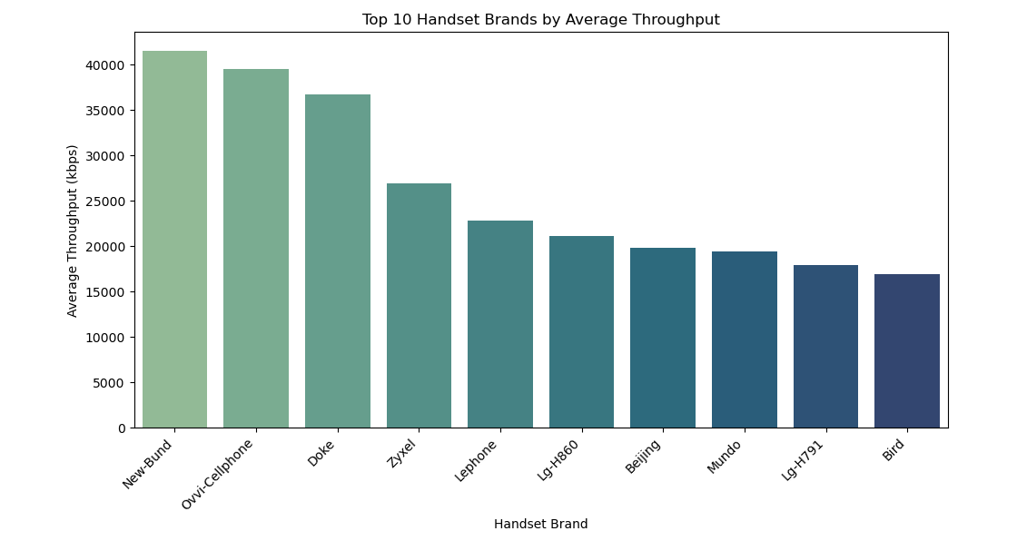
Experience Analysis
Average RTT ● Handset type
[458]:
This bar chart visualizes the Top 10 Handset Types by Average RTT (Round-Trip Time), comparing how different handset types perform in terms of network latency.
Average Throughput per Handset Type:
This bar chart visualizes the Top 10 Handset Brands by Average Throughput, showcasing which brands deliver the highest average network throughput (in kbps).

Slide 15
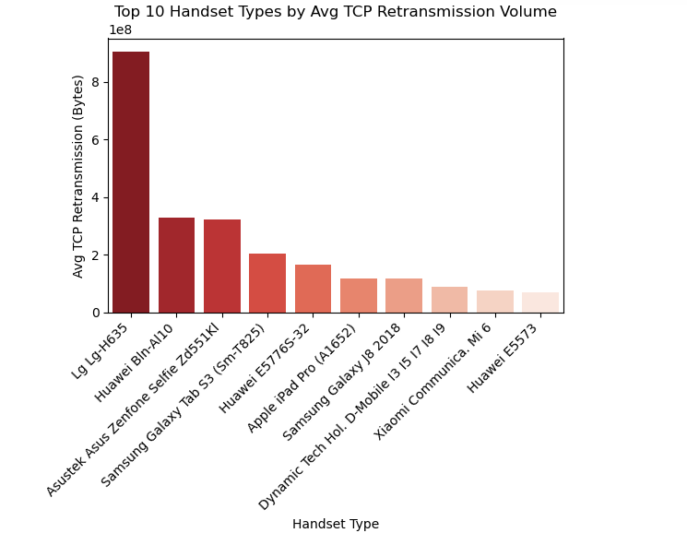
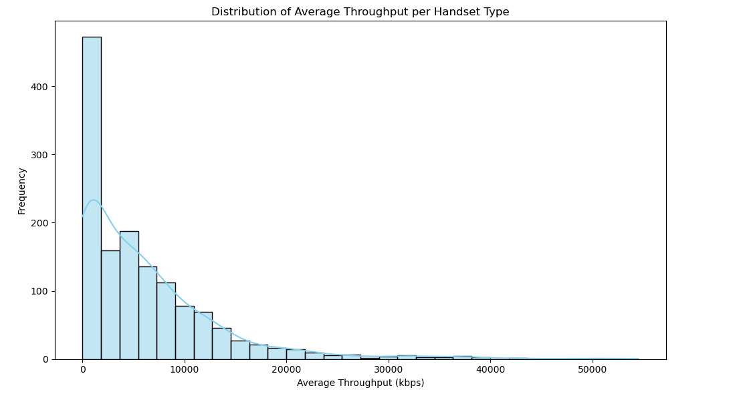
Compute & report
Average TCP Retransmission per Handset Type
Distribution of Average Throughput per Handset Type
1.Right-skewed: Most handsets fall in the lower throughput range, while a few models have very high throughput.
2.Outliers: A small number of high-end devices might cause long tails.
3.Performance gap: There’s a significant performance difference between handset types in network quality.
"High retransmission may indicate.
Poor network quality for those handsets.
Older or budget phones with weaker antennas or chipsets

Slide 16
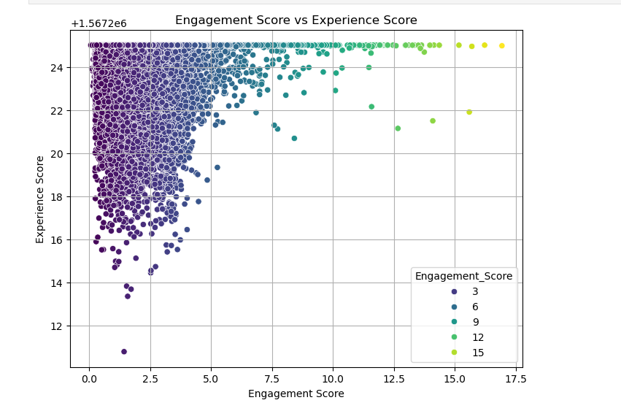
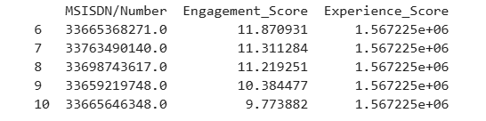
Engagement_Score and Experience_Score
Visualization¶
This scatter plot visualizes the relationship between Engagement Score and Experience Score, with points colored according to their Engagement Score.

Slide 17
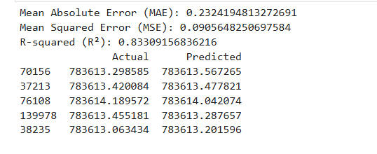
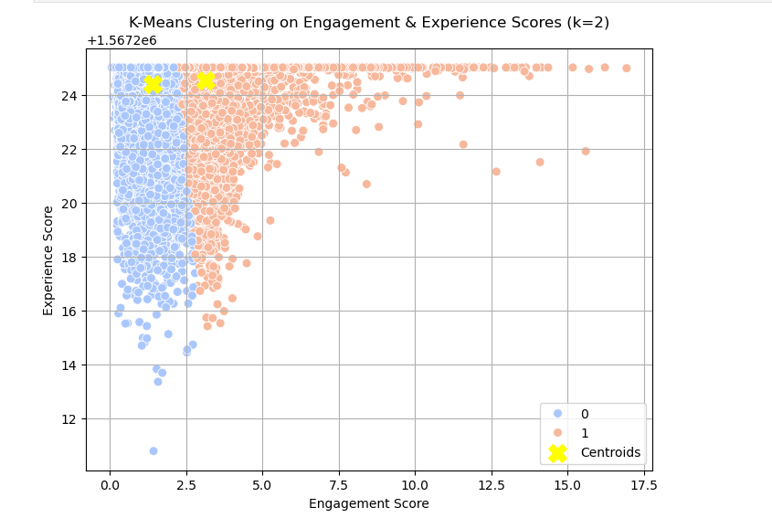
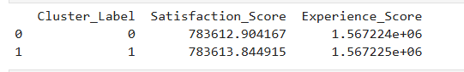
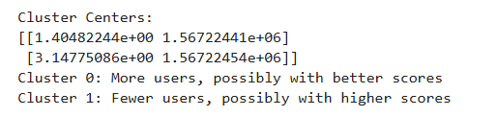
Regression model
k-means (k=2) clustering on the engagement & the experience score
Satisfaction score

Slide 18
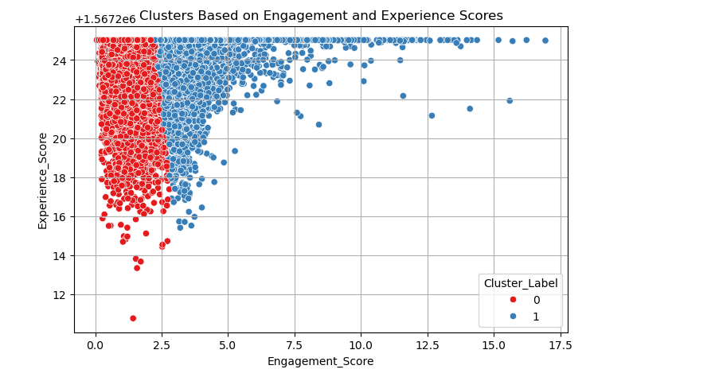
This scatter plot visualizes user clusters based on Engagement Score and Experience Score
Cluster Separation: The plot shows how users are grouped according to their engagement and experience, with each cluster represented by a distinct color.
Cluster Behavior: By analyzing the distribution of clusters, you can identify groups of users with similar behaviors or needs, helping tailor strategies for each cluster.

Slide 19


